Slide 1
Effects of Stock Holding Policy on Maize Prices:
Evidence from Zambia
Yujun Zhou, Kathy Baylis
March 7, 2019

Slide 2
Research Question:
Are stockholding policies effective in stabilizing grain prices ?
Households are vulnerable to price hikes for staple commodities. Volatile food prices can bring about economic and civil unrest ( Bellemare 2015; Fjelde 2014; Weinberg and Bakker 2015)
Many developing countries have intervened in their domestic agricultural markets to stabilize food prices to prevent shocks from domestic production and from the international price movement (Minot 2011).
Not limited to emergency reserves but as long-term food self-sufficiency policies (Calpe 2017)
Stockholding re-emerged in the early 2000s and again dominant players in African grain markets (Jayne, 2012)

Slide 3
Background
Established in 1996, the FRA purchases substantial maize from small households in various geographic regions since the 2003/04 marketing year
As a parastatal strategic food reserve/maize marketing board, has become the country’s dominant buyer of smallholder maize
However, the stock building comes at a considerable financial cost. The procurement and selling of maize at subsidized prices along with the input subsidies account for over 43% of the total agricultural budget (Nkonde et al. 2011 ).
Notes:
investments are needed to build silos and warehouses; maintenance costs are not trivial and quality may be impaired if the cereals are not rotated regularly.

Slide 4
Research Question:
Can FRA purchases raise prices for surplus maize producers during time of harvest?
Can FRA sales mitigate retail price swings associated with domestic production shocks?
Notes:
Even though buffer stocks schemes are defined as policies that stabilise prices by keeping prices between a price band, in practise, buffer stocks are mostly used to raise producer prices. In these situations, the distinction between price support programs and buffer stock schemes becomes blurred

Slide 5
Preview of Results:
Controlling for other policies in place, we find evidence of stabilizing effects of FRA activities on retail prices in the major district markets (1%-4% decrease through FRA sales).
FRA purchases raise local prices for surplus maize producers during the time of harvest ( 1%-3% increase in price for an average amount of FRA purchase)
FRA sales help to lower the price during the lean seasons.
( 0.7%-7% decrease in price for an average amount of FRA purchase)

Slide 6
Contribution
Provides empirical evidence on whether stockholding programs stabilize consumer price over space and time by conducting research on a wide range of maize markets in Zambia
Most studies evaluating stock-holding programs use VAR-type analysis on a limited number of markets while the effects of program vary over time and space
Solve endogeneity issue in the purchase and sales by using instrumental variables
Notes:
There is little evidence of buffer stocks stabilising consumer prices. This is mainly due to the fact that buffer stocks are more adept by nature at preventing price drops than curbing price hikes and are more often used to raise prices.

Slide 7
Literature Review: Theoretical
Commodity storage models as early as Gustafson (1958), further developed by Scheinkman and Schechtman (1983) , Wright and Williams (1982), Williams and Wright (1991, Chapter 14), Miranda and Glauber (1995) and others help us understand the value of building buffer stock in stabilizing prices.
Using a rational expectations storage model, Gouel and Jean (2012) proposed a theoretically optimal food price stabilization policy for a small developing country is to maintain a public stock along with a subsidy on agricultural production to prevent shocks from domestic production and international prices.

Slide 8
Literature Review: Empirical
 | Country | Stabilizing | Purchase | Sales
Jayne et al. (2008) | Kenya | Yes | Positive
Chapoto and Jayne (2009) | Zambia |  | No effect | Negative
Mason and Myers (2013) | Zambia | Yes | Positive
Pierre et al (2018) | Tanzania |  | No effect | Negative(for some mkts)
Rashid and Negassa (2011) | Ethiopia | Yes
Intal et al. (2012) | Philippines | Yes | No effect
This Study | Zambia | Yes | Positive | Negative
Notes:
In Kenya, average price levels increased around 20% between 1995 and 2004 (Jayne et al., 2008), while mean maize producer prices in Zambia rose by 17% between 1996 and 2008 (Mason and Myers, 2013).
Rashid and Negassa (2011) examine cereal price variability during the past three decades and show that price volatility was lower during the 1990s, when EGTE operated its buffer stock, compared to the 2000s, when EGTE had withdrawn from cereal price stabilisation.
The authors argue that the higher price volatility in the 2000s cannot be attributed to the absence of EGTE.

Slide 9
Framework: a system of Demand and Supply
Supply
Ag Inputs, Weather, Net Import
FRA
Demand
Income, Copper Price, Export Ban
Smooth price
intra-year, inter-year, and over space
FRA Purchase
(July – October)
FRA Sales
(Dec-March)
Notes:
The FRA buys maize from smallholders at a pan-territorial price that typically exceeds wholesale private- sector prices in major maize-producing areas.
Low-harvest years, sell to large-scale millers at below market prices
subsidized sales to millers

Slide 10
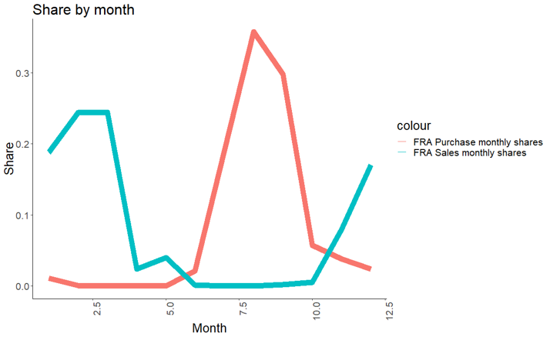

Slide 11
Spatial Variation

Slide 12
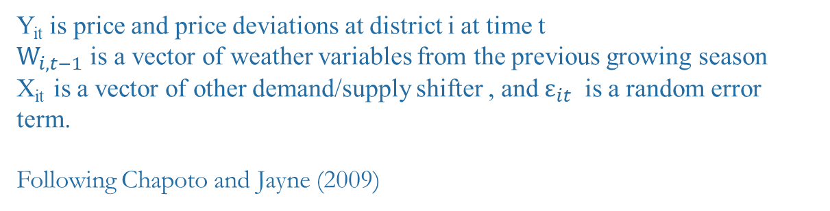

Reduced Form Model
$$Y_{it}=Y_{i,t−1}+ {FRA_buy}_{it}α+{FRA_sale}_{it}β+W_{i,t−1}γ+X_{it}+{month}_{t}+{mkt}_{i}+ε_{it}$$
Y_{it} is price and price deviations at district i at time t
$W_{i,t−1}$ is a vector of weather variables from the previous growing season
X_{it} is a vector of other demand/supply shifter , and $ε_{it}$ is a random error term.
Following Chapoto and Jayne (2009)

Slide 13
Endogeneity: Purchase
FRA targets explicitly areas that are predicted to be in surplus as locations for their purchases and possibly target more purchase in a bad year
Instrument for FRA purchases using FRA stated purchase behavior (purchase target directed by CFS prediction of harvest)
If not, FRA actions are correlated with changes in production over time and space. Overestimate the effect of FRA purchases on stabilizing the prices since FRA purchase are typically made in places of surplus maize and price tend to be more stable.

Slide 14
Construction of IV: FRA Purchase
Predicted FRA purchases at district i at month t:
- Predicted national production of a certain year * Long-run average of district i’s share in the total national production * Average monthly shares of FRA purchase
(Predicted production and long-run average shares calculated from the Crop Forecast Survey )
Relevance
CFS is sampled to estimate national harvest and used as references for setting goals for FRA purchases and FRA purchase price
Argument around Exclusion Restriction
Using long-run averages shares, not specific to a specific year’s harvest and hence not impacting the current local prices directly
CFS estimate may not be accurate in terms of actual harvest and hence not strongly correlated with the current prices

Slide 15
Endogeneity: Sales
A possible reverse causality exists as FRA tends to sell more maize when the price is higher.
Instrument for FRA Sales using predicted production weighted by distance to nearby millers and number of millers and limit to months that sales tend to occur
Strip out annual * district variation where other policy might respond to local supply and demand
If not, the effects of sales would appear to increase prices

Slide 16
Construction of IV: FRA Sales
Predicted FRA Sales at district i at month t:
Predicted district i’s FRA stock of a certain year * Distance weights to nearby districts with millers * Average monthly shares of FRA Sales
Relevance
Predicted FRA stock from CFS correlated with actual FRA stocks that a district has
Exclusion
Distance to districts with milling companies don’t change, at least not in a few years
Using long-run averages shares, not specific to a specific year’s harvest and hence not impacting the current local prices directly

Slide 17
Endogeneity: Simultaneous policies
“It is practically impossible to separate stockholding policies from other domestic policies. Any government program that involves buying or releasing cereals leads to the creation of public stocks” (Deuss 2014)
Fertilizer Input Subsidy Program , Export Ban on maize, government initiated imports
Mostly year-over-year variations
Removed by having the lagged price and agriculture-related weather shocks in the regression

Slide 18
Data
Monthly Zambia retail maize prices of 32 markets from Jan. 2003 to Dec. 2008
Annual Zambia FRA purchases from 2002 to 2009 by the district from the FRA, and monthly national total purchase
Monthly national FRA sales from the FRA
Agriculturally-relevant precipitation from the Climate Hazards Group InfraRed Precipitation with Station (CHIRPS) during the October–April growing season.
Temperature data from the African Drought Monitor

Slide 19
Price Regressions
Notes:
Programs that raise prices for producers, usually also raise them for consumers, and vice versa for schemes that aim to lower prices.
Buffer stock intervention is therefore more effective at limiting price fails than curtailing the incidence and magnitude of price spikes (Wright, 2012).

Slide 20
Price Deviation Regressions
Notes:
Programs that raise prices for producers, usually also raise them for consumers, and vice versa for schemes that aim to lower prices.
Buffer stock intervention is therefore more effective at limiting price fails than curtailing the incidence and magnitude of price spikes (Wright, 2012).

Slide 21
Results:
Controlling for other policies in place, we find evidence of stabilizing effects of FRA activities on retail prices in the major district markets (1%-4% decrease through FRA sales).
FRA purchases raise local prices for surplus maize producers during the time of harvest ( 1%-3% increase in price for an average amount of FRA purchase)
FRA sales help to lower the price during the lean seasons.
( 0.7%-7% decrease in price for an average amount of FRA purchase)

Slide 22
Other things to consider…
Management and transparency: late payment
Fiscal impact: worth it ?
Opportunity cost in investing other programs
Crowding out of the private sector: government face a bigger role, and then more pressure on the budget
International spillovers: for large country, generates nervousness on the international markets; for small country, impact neighboring countries

Slide 23
Other things to consider…
Spatial lag
Transportation cost
Robustness checks
Subset samples : by region, by distance

Slide 24
Thank you !

